Slide 1
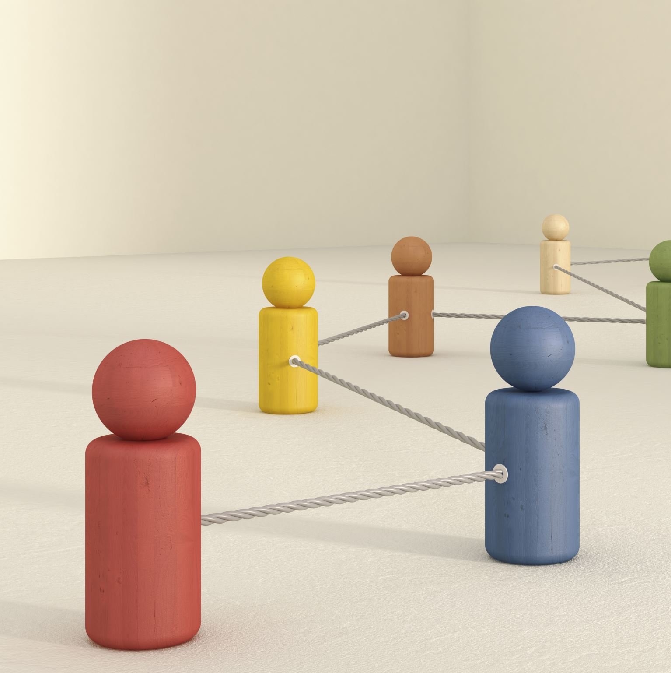
Clustering -Customer Segmentation
Neelam Chouhan
DSFT 8

Slide 2
Project Objective
Increase Revenue And Customer Satisfaction.
Will help to identify the right products for the various clusters of customer.
Strategize the way products and services are sold to appeal to the right customers
Attract target customers with high spending power to spend more.
Introduce strategies for the customers with low spending power to start spending more.

Slide 3
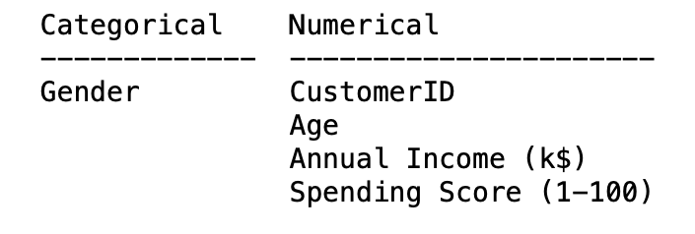
Let’s understand our data.
Data has 200 rows and 5 columns.
We can see the data types of the various columns
Workflow Flow Of This Project
Loading the dataset
Understanding the data and get some domain knowledge.
Exploratory Data Analysis
Data Pre-processing
Dataset is ready.
Processed Data
Finding the optimal K value
Model Building using various Algorithms
Cluster Predictions
& Visualization
Model Selection
Inferences

Slide 4
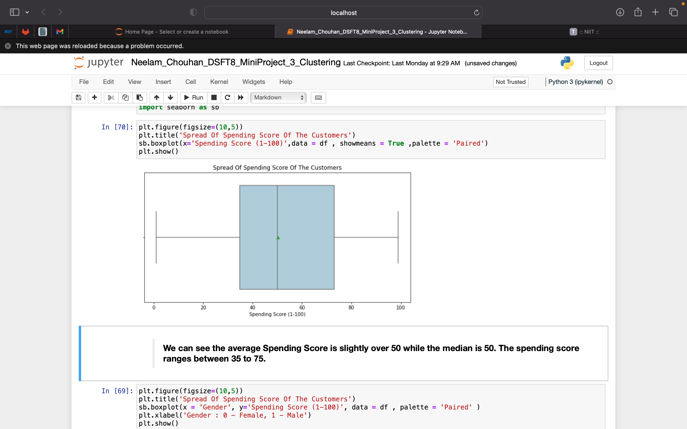
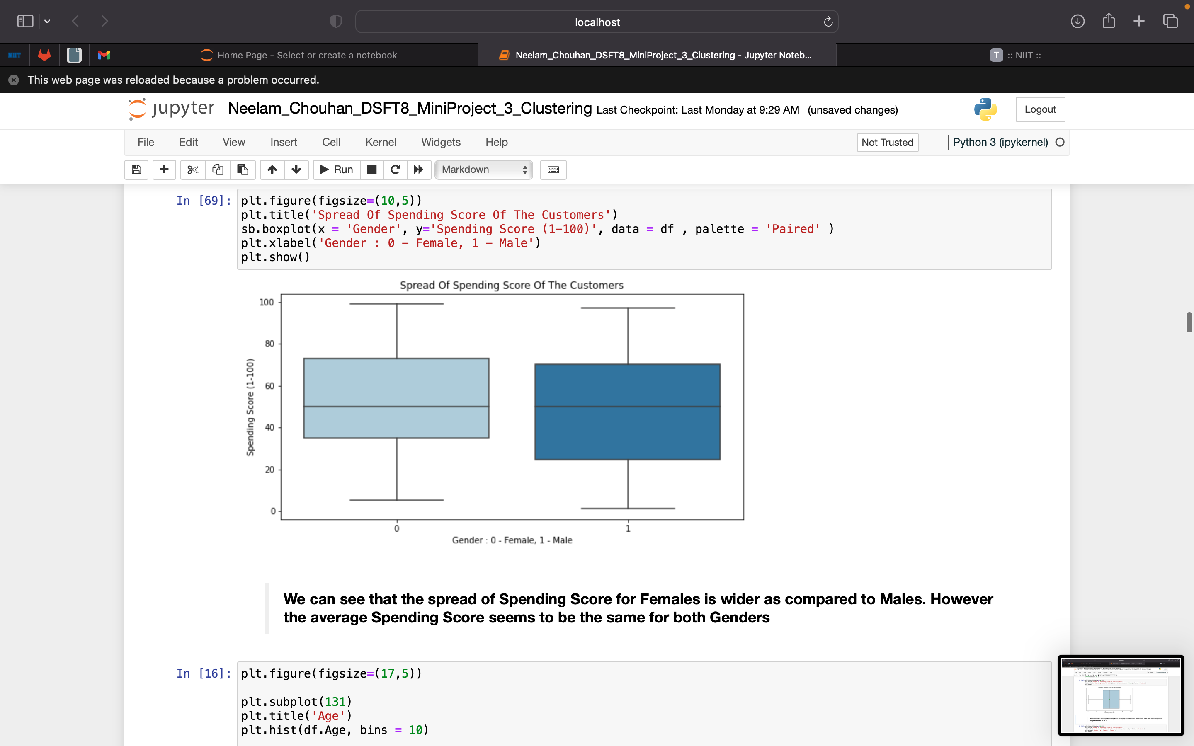
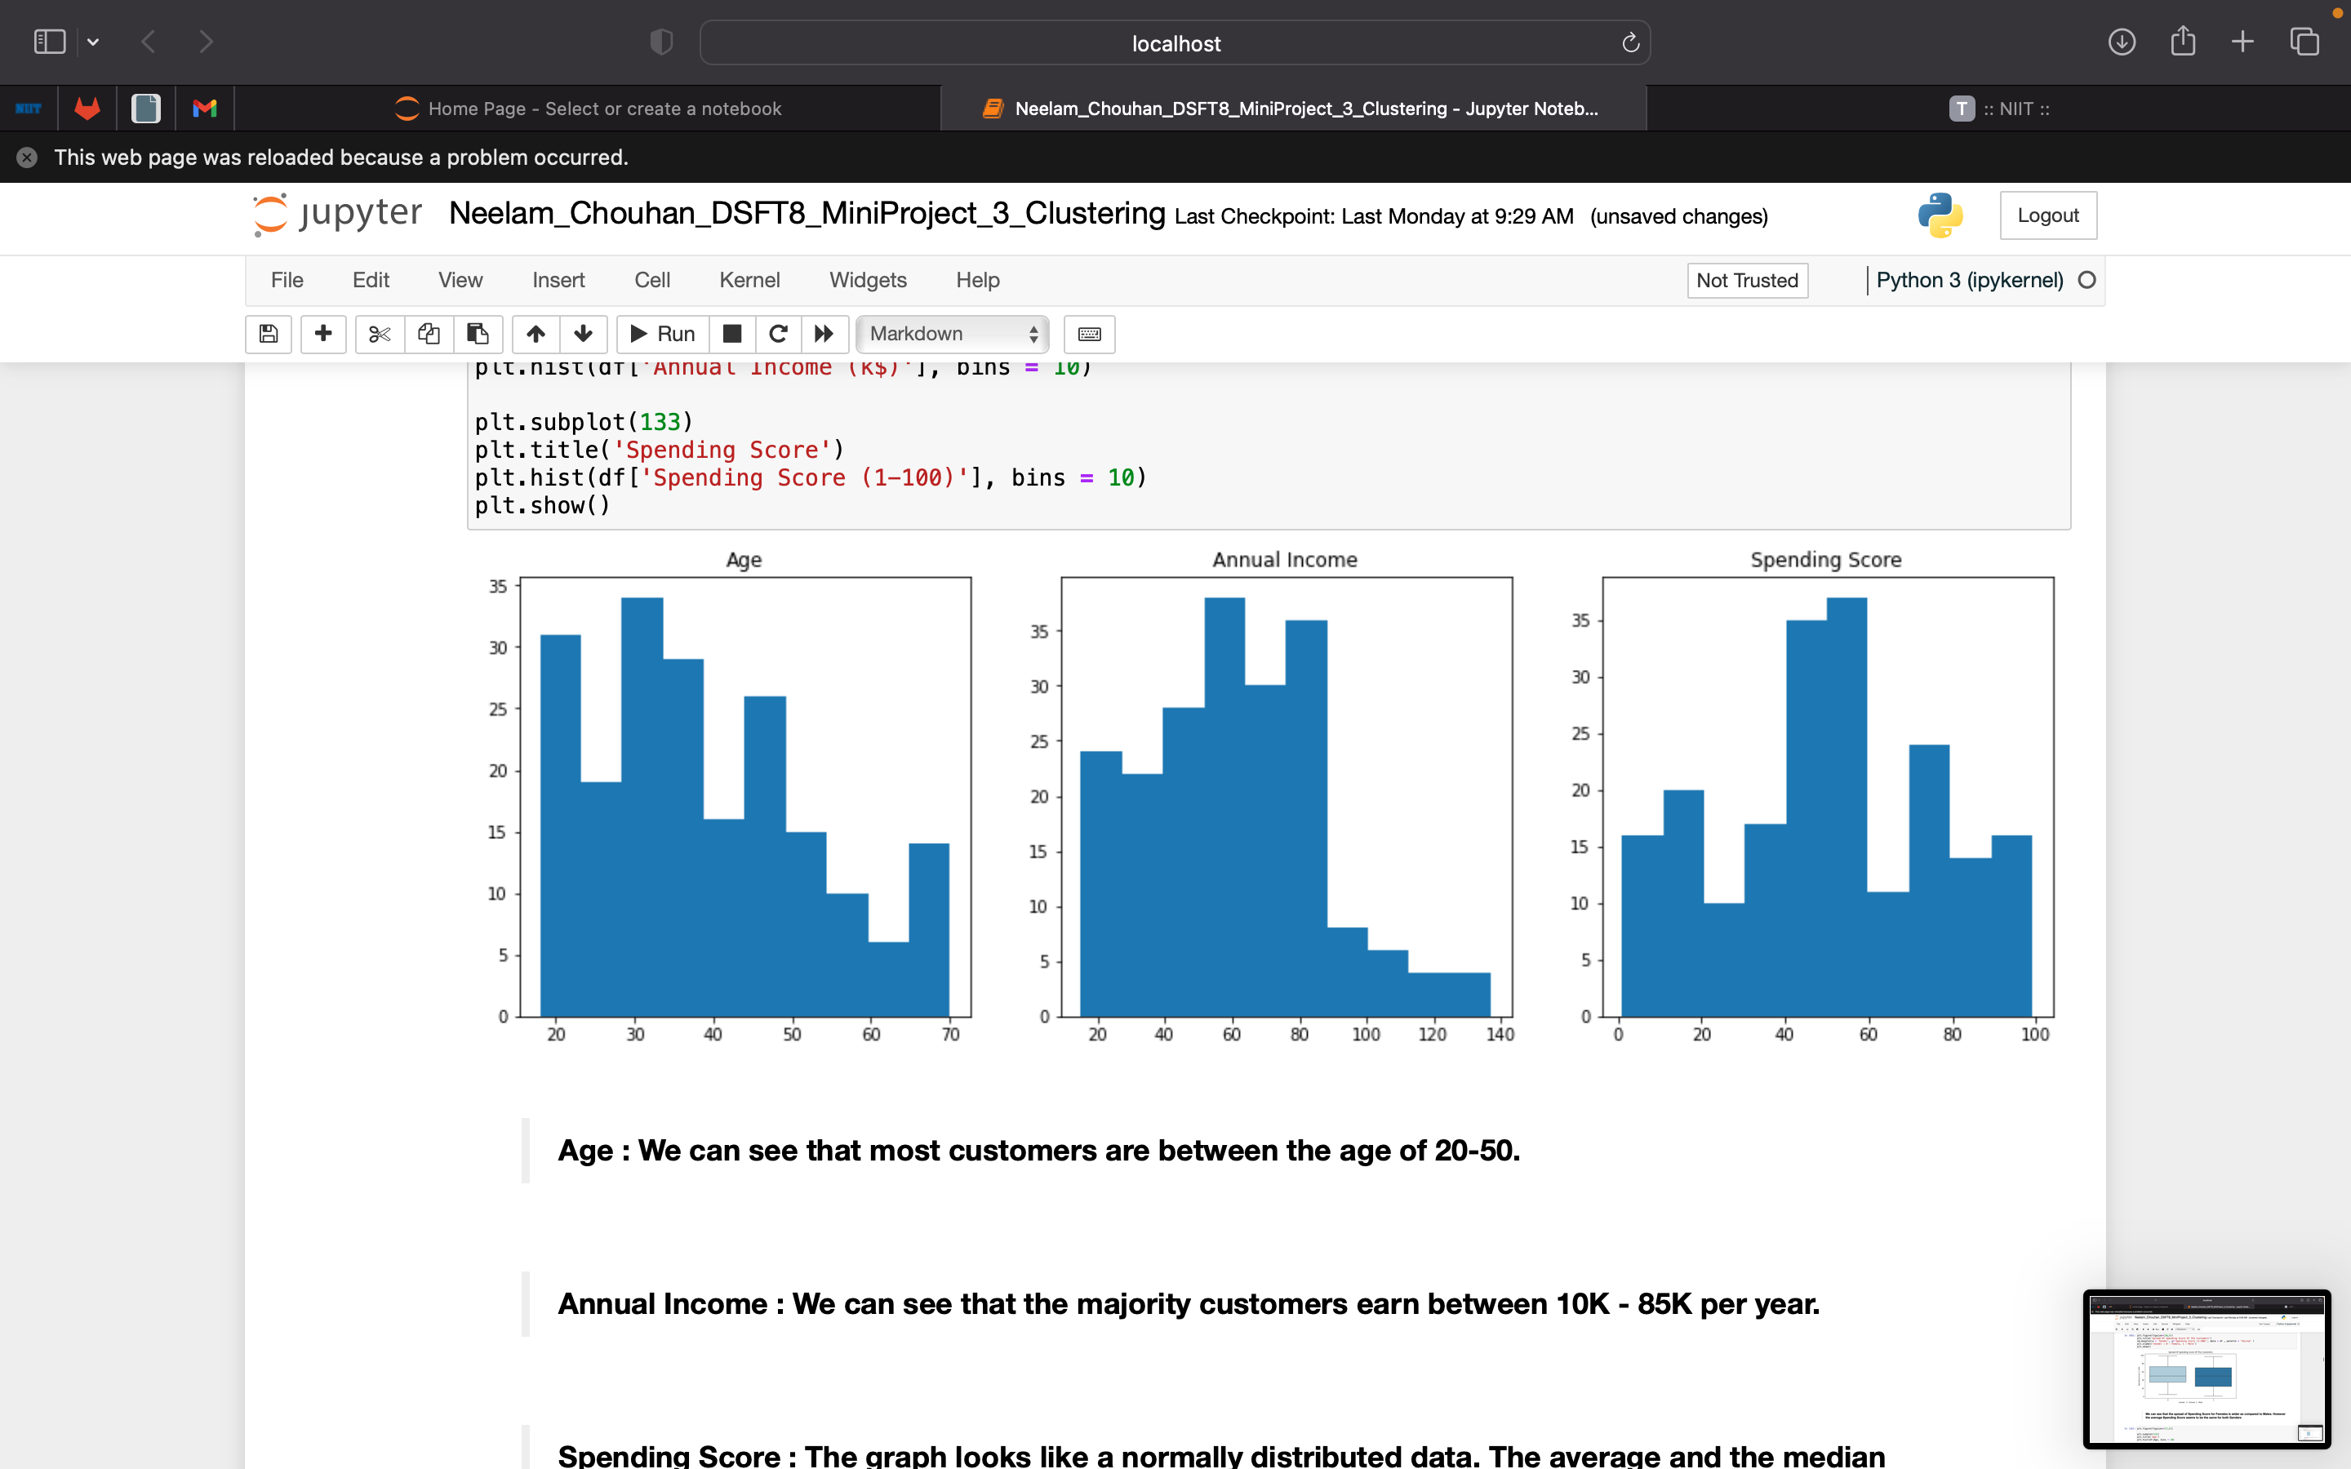
EDA
We can see the average Spending Score is slightly over 50 while the median is 50 and ranges between 35 to 75.
Spending Score : The graph looks like a normally distributed data. The average and the median spending score seems to be 50.
We can see that the spread of Spending Score for Females is wider as compared to Males. However, the average Spending Score seems to be the same for both Genders.
Age : We can see that most customers are between the age of 20-50.
Annual Income : We can see that the majority customers earn between 10K - 85K per year.
Notes:
We can see the average Spending Score is slightly over 50 while the median is 50.
The spending score ranges between 35 to 75.
Spending Score : The graph looks like a normally distributed data. The average and the median spending score seems to be 50
We can see that the spread of Spending Score for Females is wider as compared to Males. However, the average Spending Score seems to be the same for both Genders.
Age : We can see that most customers are between the age of 20-50.
Annual Income : We can see that the majority customers earn between 10K - 85K per year.

Slide 5
Model Building
Since this is a Clustering problem, we will be trying different classification algorithms to see which model gives us the best results.
K-Means
Hierarchical Clustering
DBSCAN
Comparison of Models
We will compare the various algorithms based on the silhouette scores.
We will also check the scatter plots to see which clusters are more very dense and nicely separated.

Slide 6
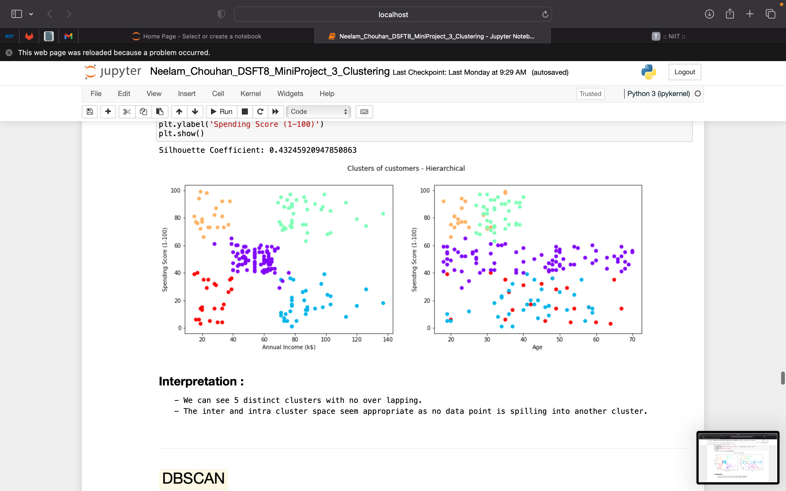
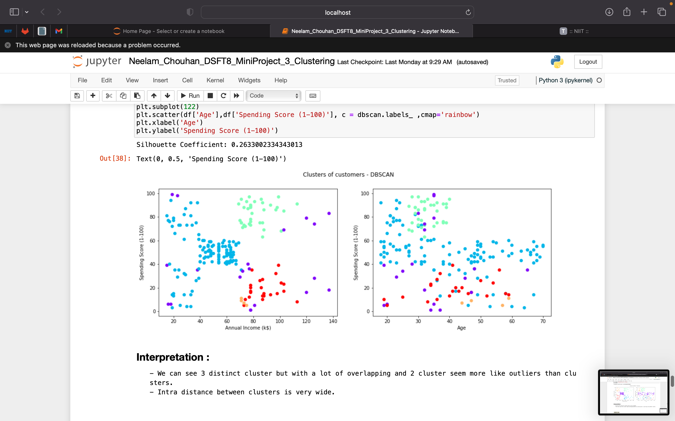
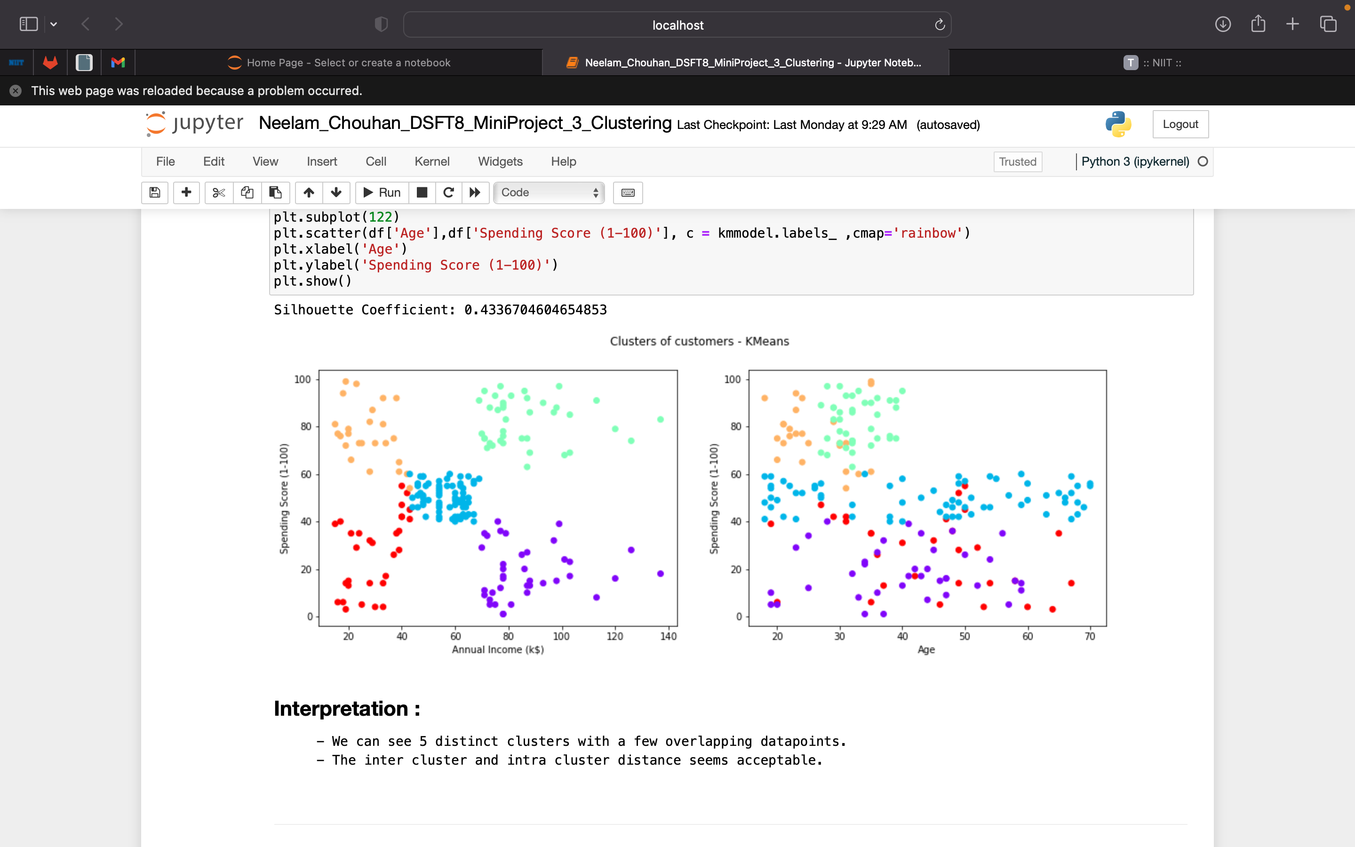
Comparing Clusters of Models
We choose Hierarchical model as it gives us the densest nicely separated and distinct clusters as compared to the other models.

Slide 7
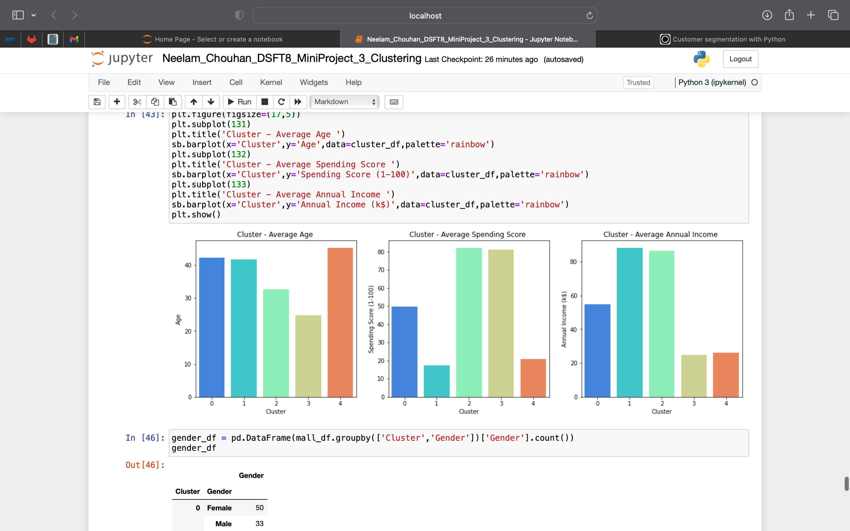
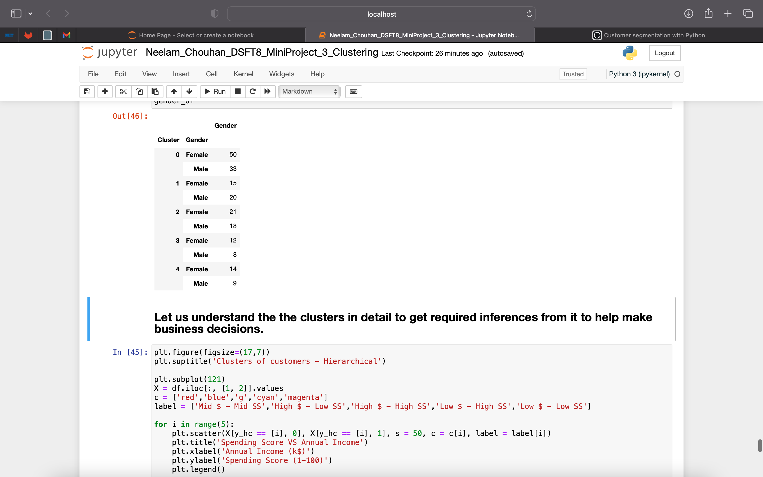
Understanding Our Clusters To Make Business Decisions.
Age : The cluster with the oldest average age is cluster 4 and the youngest crowd belongs to cluster 2.
Spending Score : The highest spending Score is highest in cluster 2 followed by 3 and lowest in cluster 1.
Annual Income : The Highest average income is highest in cluster 1 and lowest in cluster 3.
Customer Count : Cluster 0 has the most customers while the cluster 3 has the least count of customers.

Slide 8
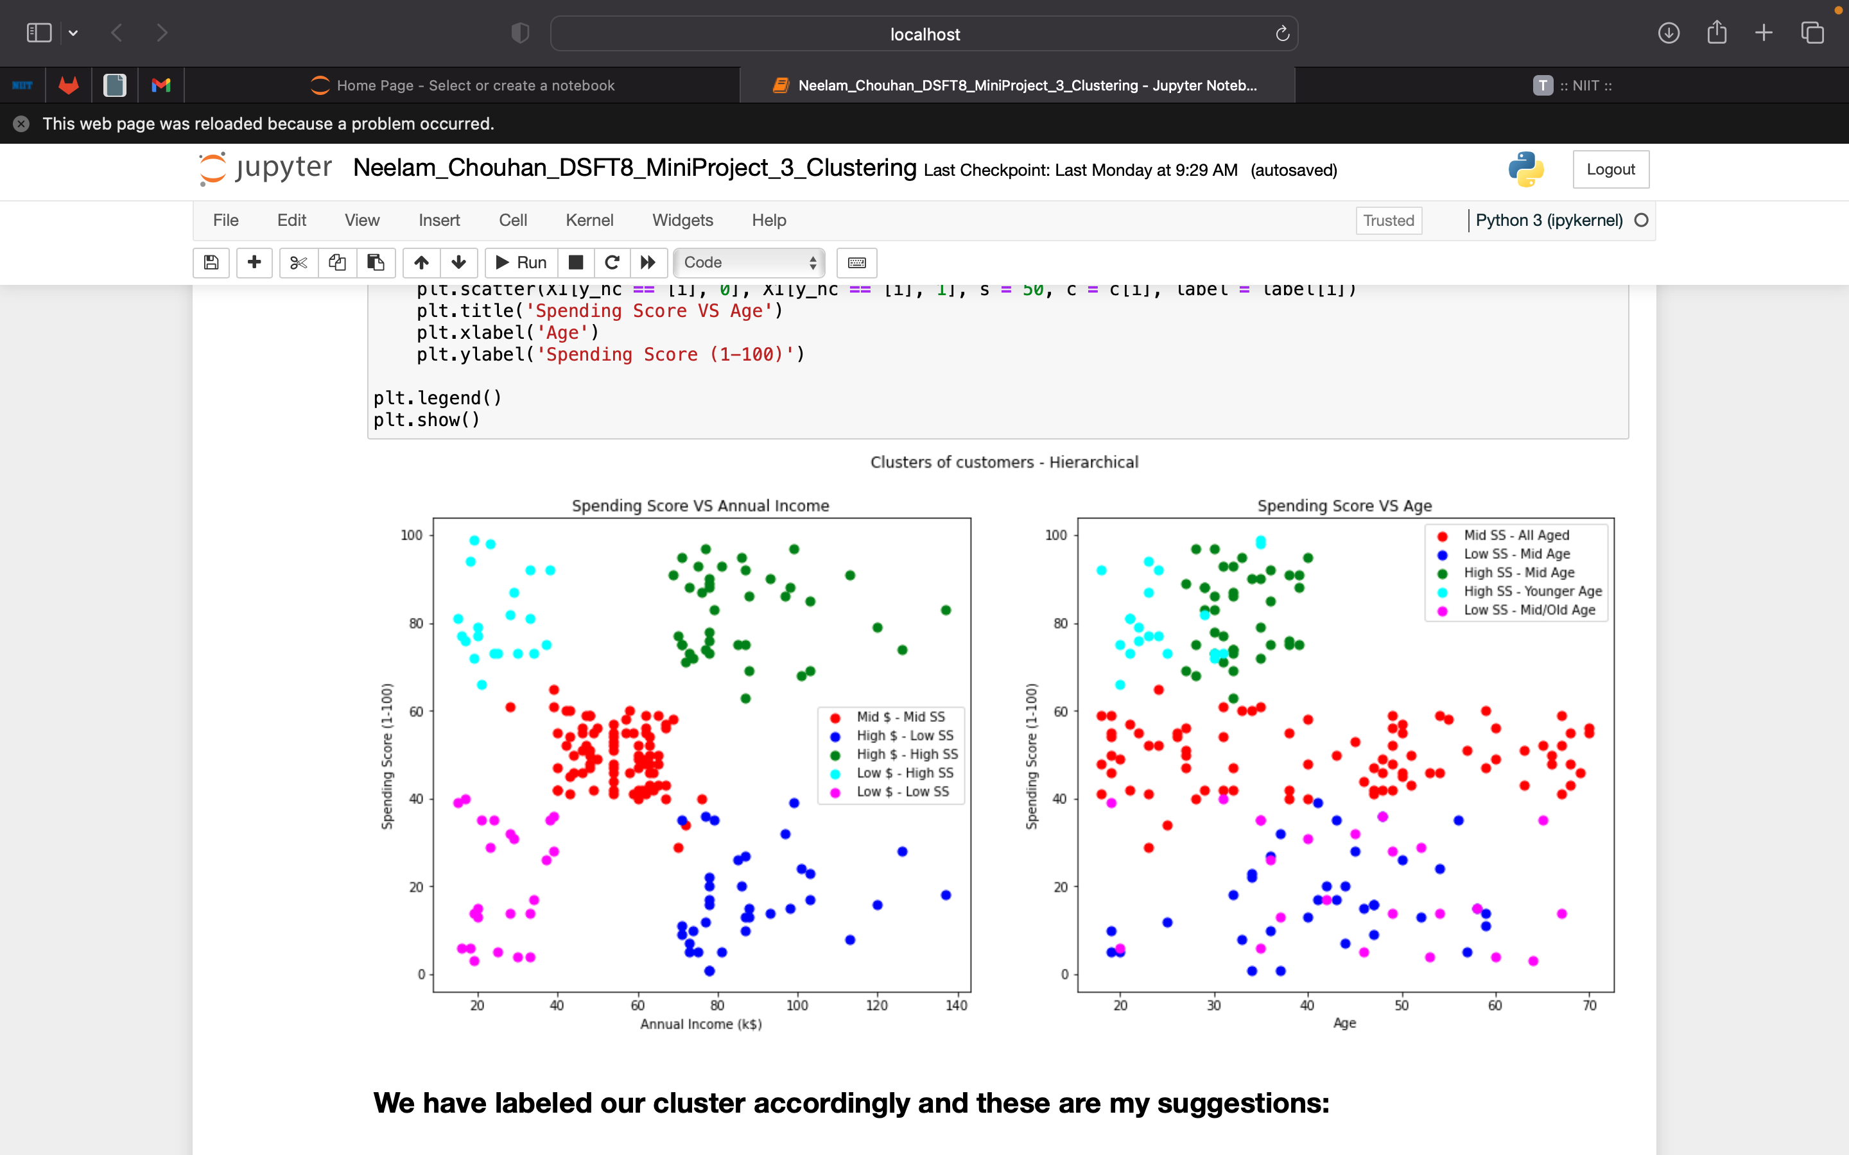
Labeling the clusters. Since the cluster represent similar properties, we have labeled each one of them that represent the traits of the cluster.

Slide 9
Business Suggestions
Red Cluster :
Mid income and mid spending score
Range across all ages
Green Cluster:
High-income high spending score and relatively younger batch of people.
Blue Cluster :
High income and low spending score.
Marketing strategy through social media or promotional emails to pull in such customers.
Cyan Cluster :
Low income but higher spending score.
Promos, coupons, and discount codes like back to school or some discounts forwill attract individuals
Pink Cluster:
Low Income Low Spending Score.
A survey to understand background of the customers will help introduce cheap products or discounts.
As they are our more profitable clients, and we need strategies like membership plans , member exclusive deals to retain them.

Slide 10
Thank You

